Slide 1


THE FUTURE OF ENTERTAINMENT
PROSUMER REPORT
DOES YOUR CONTENT REALLY MATTER?

Slide 2
ABOUT THE STUDY
METHODOLOGY
From CGI and AR to smart speakers and streaming services, the digital
era has revolutionized the field of entertainment. Even more consequential are the fundamentally new ways in which people consider and consume entertainment. This Prosumer Report seeks to understand what’s next for entertainment and how brands can contribute in more meaningful ways.
Key insights uncovered:
Created by Havas Group, part of Vivendi,
in collaboration with Cannes Lions
Fielded by Market Probe International in 1Q19
17,411 respondents age 13+ in 37 markets
Who Are Prosumers?
Entertainment now sits at the center of human existence—and people have a seemingly inexhaustible appetite for more. We want elements of entertainment to be infused across workplaces, schools, healthcare, and beyond.
Tensions exist between people’s desire to “switch on” and “switch off ”—including serious concerns about the impact of 24/7 entertainment on children. Can imaginations grow in the absence of boredom?
Gen Zs are under tremendous pressure to contribute to entertainment culture, both by creating content and by showcasing enviable lifestyles.
Video games are now considered a meaningful form of art, on a par with books, paintings, and movies.
Artists can no longer rely on their art alone. With so much content available, people most value artists who stand for something.
The power of entertainment lies in its ability to transform, educate, and enrich. As much as we crave temporary escapes, we are also driven to create better versions of ourselves—and we are increasingly looking to entertainment for help.
In 2004, the first global Prosumer study was conducted in nine countries. In the ensuing years, Havas Group’s Prosumer studies have become instrumental in predicting emerging trends in consumer attitudes and behaviors.
Prosumers are today’s leading influencers and market drivers. What Prosumers are doing today, mainstream consumers will likely be doing 6 to 18 months from now.
2

Slide 3
no longer superficial, ENTERTAINMENT has become as important as health
Truth
01
83%
Entertainment is now vital
Entertainment is a vital need
54%
I pay a lot of attention to health issues*
*Health and Wellness: My Body, Myself, Our Problem (2012)
Showing global totals; % agreeing strongly/somewhat

Slide 4



Truth
02
60%
56%
FOREVER SEEKING OUR NEXT FIX
Unplugged is becoming unbearable
I can’t stand still without consuming content
I would give up sleep to binge-watch a show I like
37%
I can’t live
without Netflix
Showing Prosumer responses; % agreeing strongly/somewhat

Slide 5
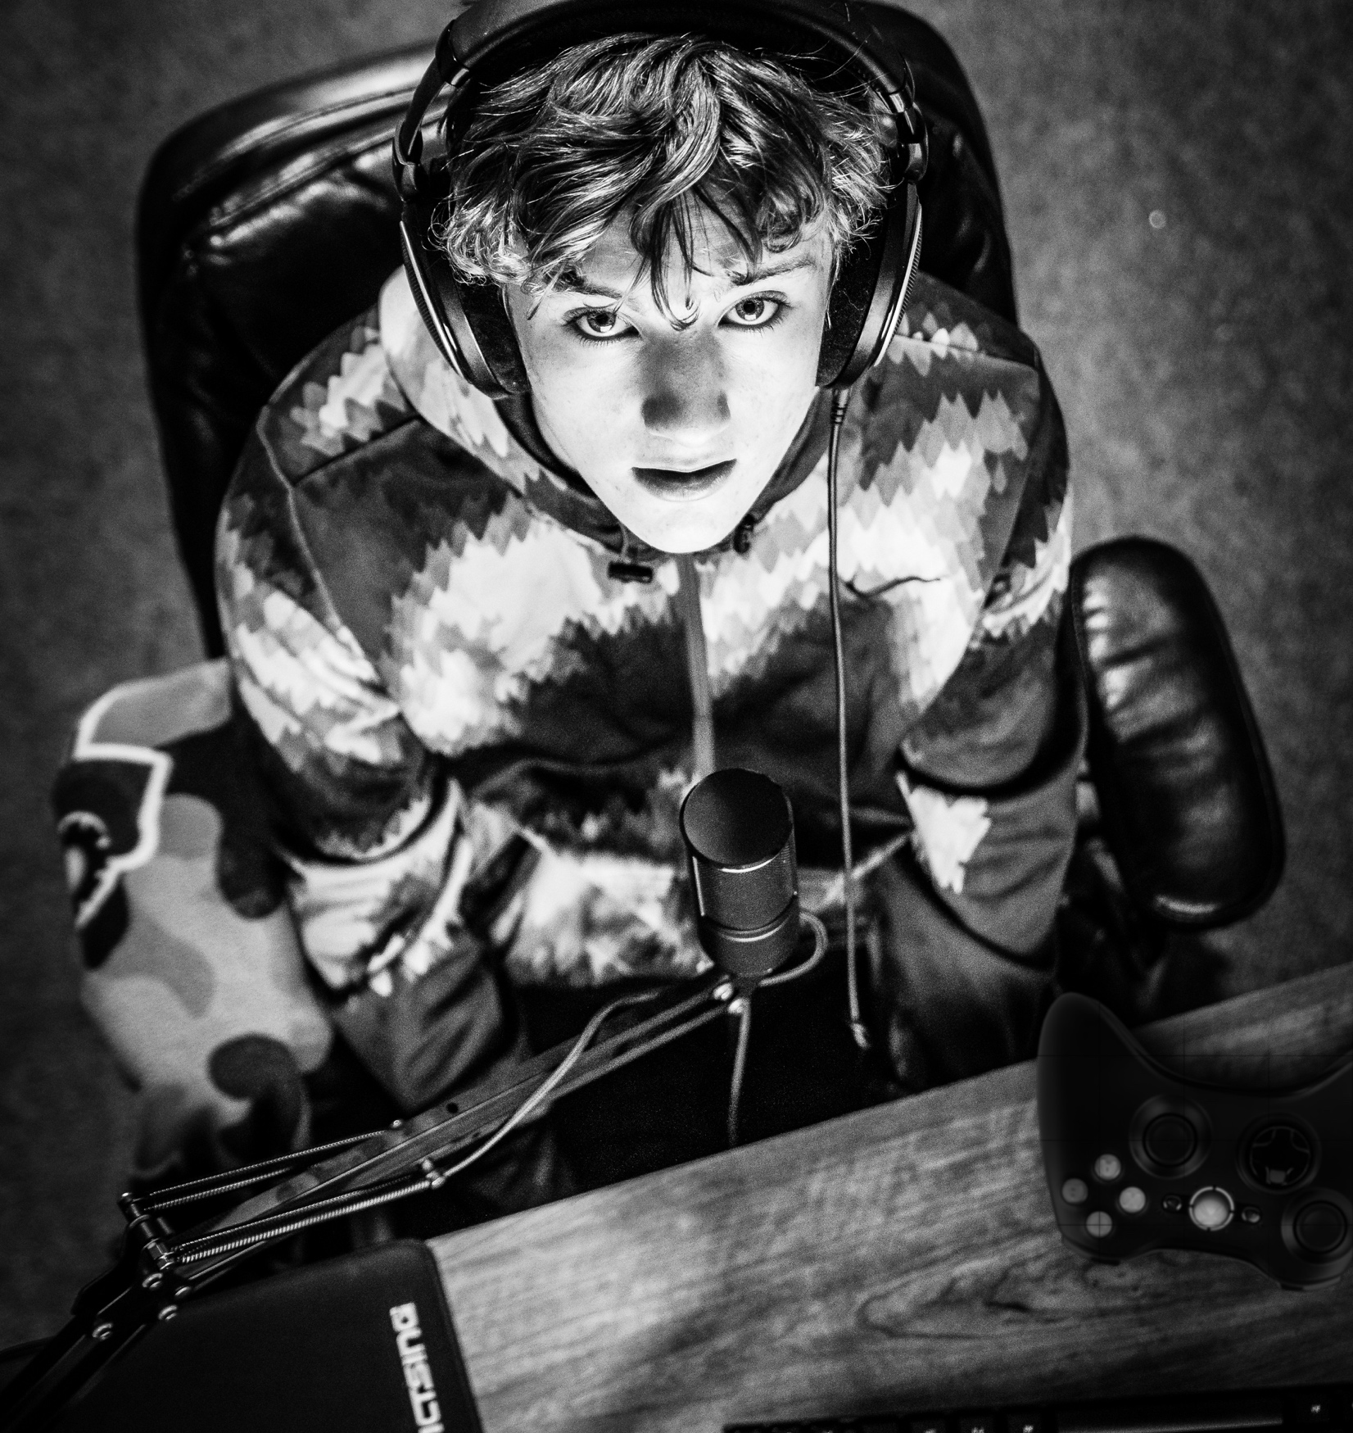






Truth
I think the following aspects
of life could be improved by being made more entertaining:
03
Gimme more!
62%
60%
55%
WE’RE SEEKING TO INJECT ENTERTAINMENT INTO VIRTUALLY EVERY FACET OF OUR LIVES
Education
Work
Family
moments
52%
42%
37%
Housework
Cooking
Hospital
stays
Showing Prosumer responses

Slide 6
Truth
04
55%
43%
We are all pixels
in a bigger picture
Gen Zs ARE under pressure to “succeed” in entertainment culture
I feel like I always need to entertain my friends, family, coworkers, etc.
I feel pressured to showcase an entertaining lifestyle on social media
41%
40%
25%
I only value entertainment
I can talk about
I worry that others
will disapprove of entertainment I consume
When I attend a concert, I spend more time sharing it on social media than enjoying it
Showing Gen Z responses—ages 13−17, in Brazil, China, France, India, UK, and US; % agreeing strongly/somewhat

Slide 7

Truth
05
93%
88%
BEYOND BINGING
THE VALUE OF ENTERTAINMENT LIES IN ITS LONG-LASTING IMPACT AND ABILITY TO EMPOWER AND EDUCATE
Cinema, music, and books are more meaningful to me when, in addition to providing immediate gratification, they have a long-lasting impact
Entertainment needs to empower
and educate people
75%
48%
Content would be more meaningful if it inspired me
I’d be willing to pay more for more meaningful entertainment
Showing Prosumer responses; % agreeing strongly/somewhat

Slide 8
Truth
06
I value entertainment that teaches me life lessons about…
73%
Openness
ENTERTAINMENT IS
A POP PHILOSOPHY
78%
Respect
WE ABSORB AGE-OLD LESSONS FROM THE MOVIES WE WATCH AND THE GAMES WE PLAY
66%
64%
Generosity
Perseverance
66%
Perseverance
Showing Prosumer responses

Slide 9


Truth
07
88%
PROMOTING LOCAL
AT A GLOBAL LEVEL
MEANINGFUL ENTERTAINMENT HIGHLIGHTS HUMAN COMMONALITIES
In a divided world, entertainment brings people of different cultures and values together
Showing Prosumer responses; % agreeing strongly/somewhat

Slide 10




Truth
08
63%
80%
Artists need to CREATE DEEPER CONNECTIONS
It’s important that artists put social issues
at the heart of the music they produce
The internet has helped me feel closer to my favorite artists
WITH MORE PEOPLE CALLING up music based on mood or activity rather than artist or album, artists NEED TO Stand up to stand out
81%
It is important to have celebrities, musicians, and movies that promote national culture
Showing Prosumer responses; % agreeing strongly/somewhat

Slide 11
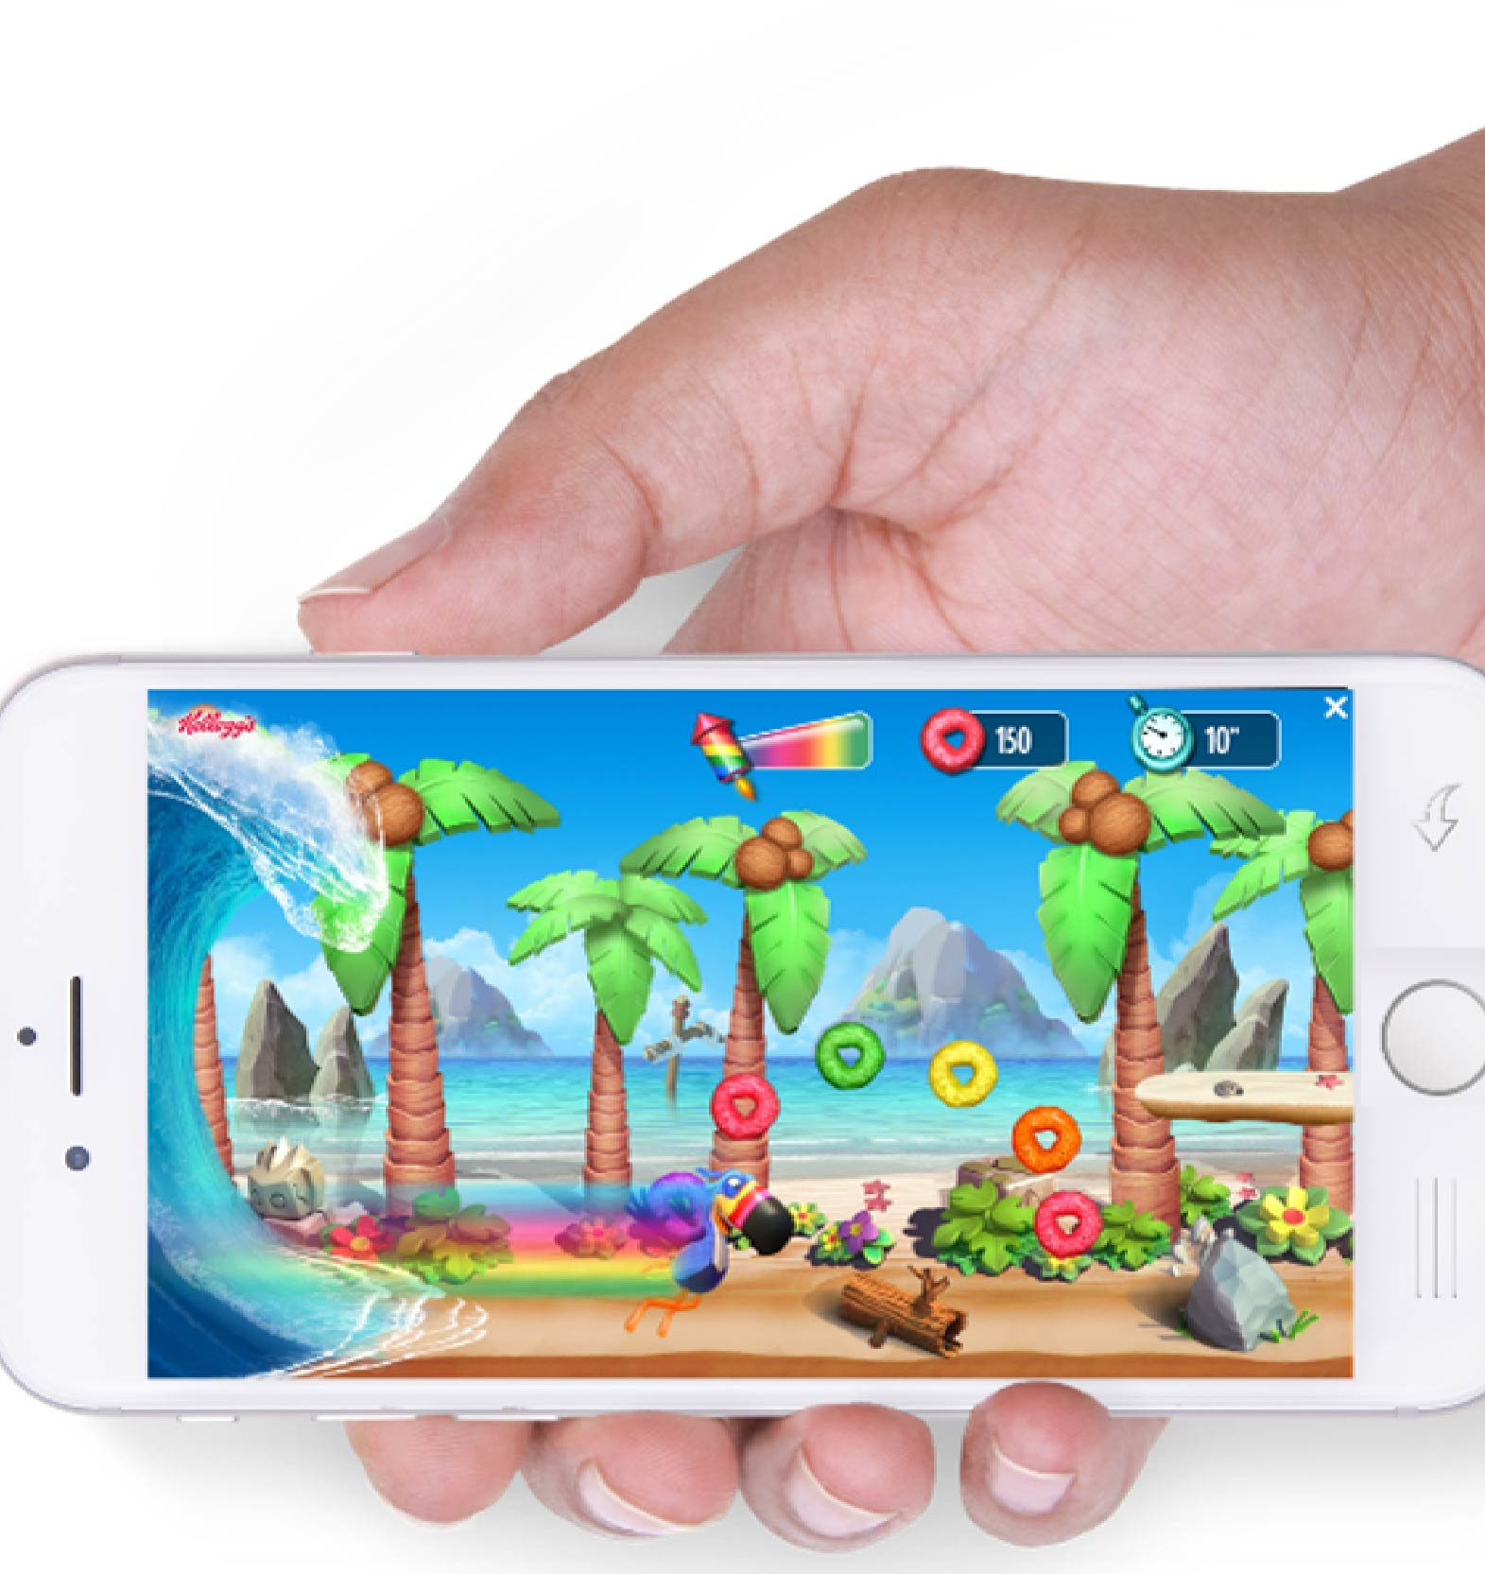
Truth
09
56%
Gen Zs
68%
Prosumers
HAIL TO THE NERDS!
VIDEO GAMES HAVE LEVELED UP IN GLOBAL CULTURE
I think video games are
as meaningful as art
(e.g., paintings, movies, books)
55%
Gen Zs
69%
Prosumers
I have video game memories that are as vivid as those from actual life experiences
% agreeing strongly/somewhat

Slide 12
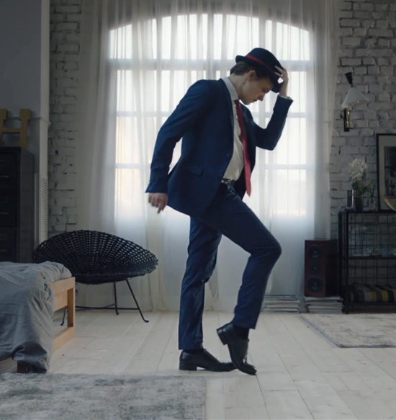


Truth
10
Advertainment wins
74%
My experiences with brands should be more entertaining
ENTERTAINMENT IS KEY TO BRAND ENGAGEMENT
71%
I’m engaged by and remember better advertising that is entertaining
69%
I would watch advertising if it were more entertaining
Showing Prosumer responses; % agreeing strongly/somewhat

Slide 13
Beyond Distraction: Who’s Doing It Right?

Slide 14
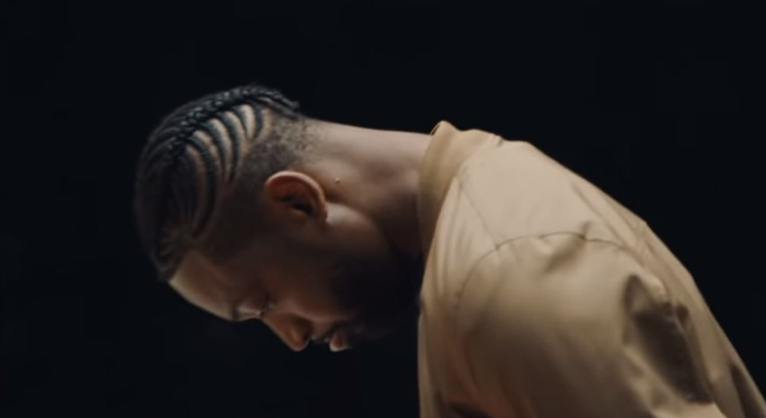
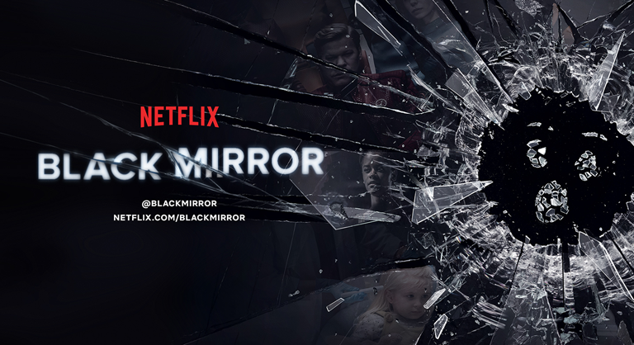
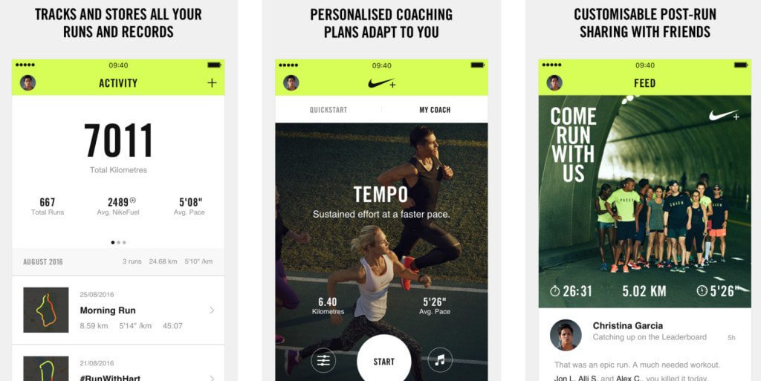
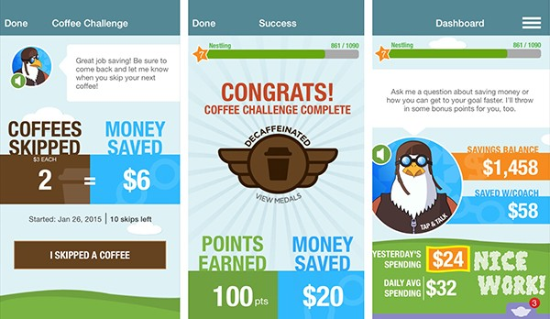


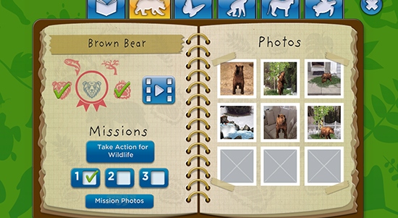
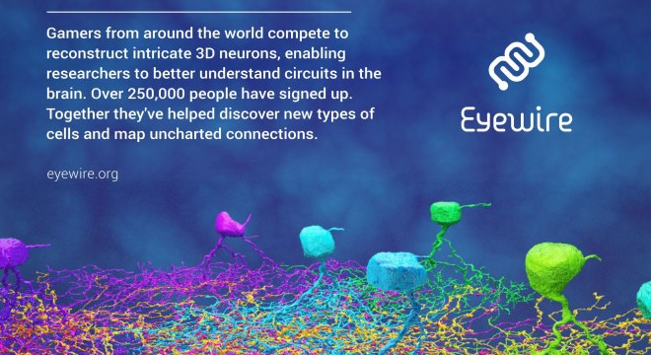
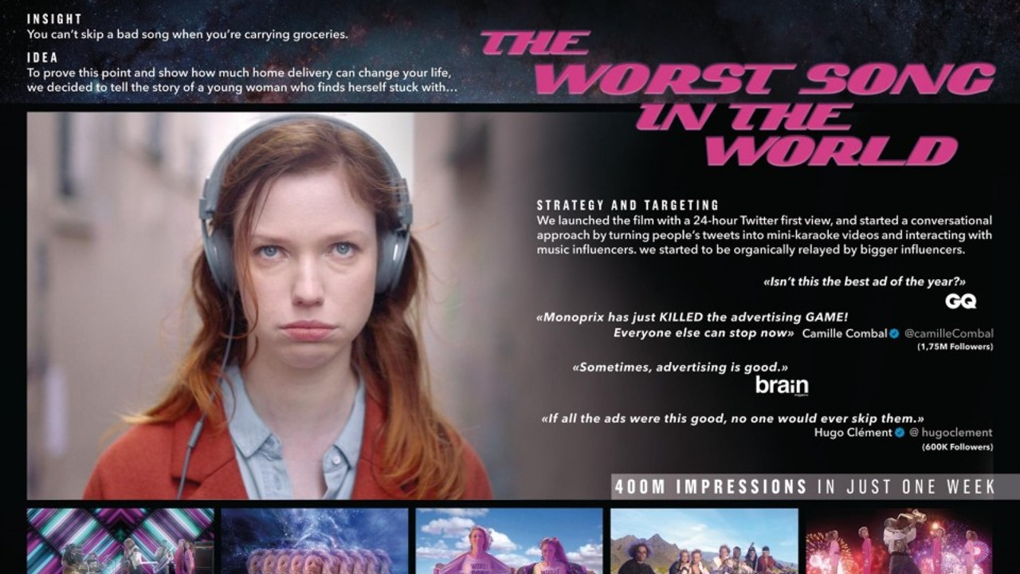
MUNDANE
MEANINGFUL
TEDIOUS
THOUGHT- PROVOKING
SOLITARY
SOCIAL
RECOGNIZE THESE?
PAIN POINT
PLEASURE
EXCLUSION
EMPOWERMENT
ARTIST
ACTIVIST
SWITCHED ON
SWITCHED OFF
GAMER
GIVER
ADVERTISING
ADVERTAINMENT

Slide 15








Slide 16
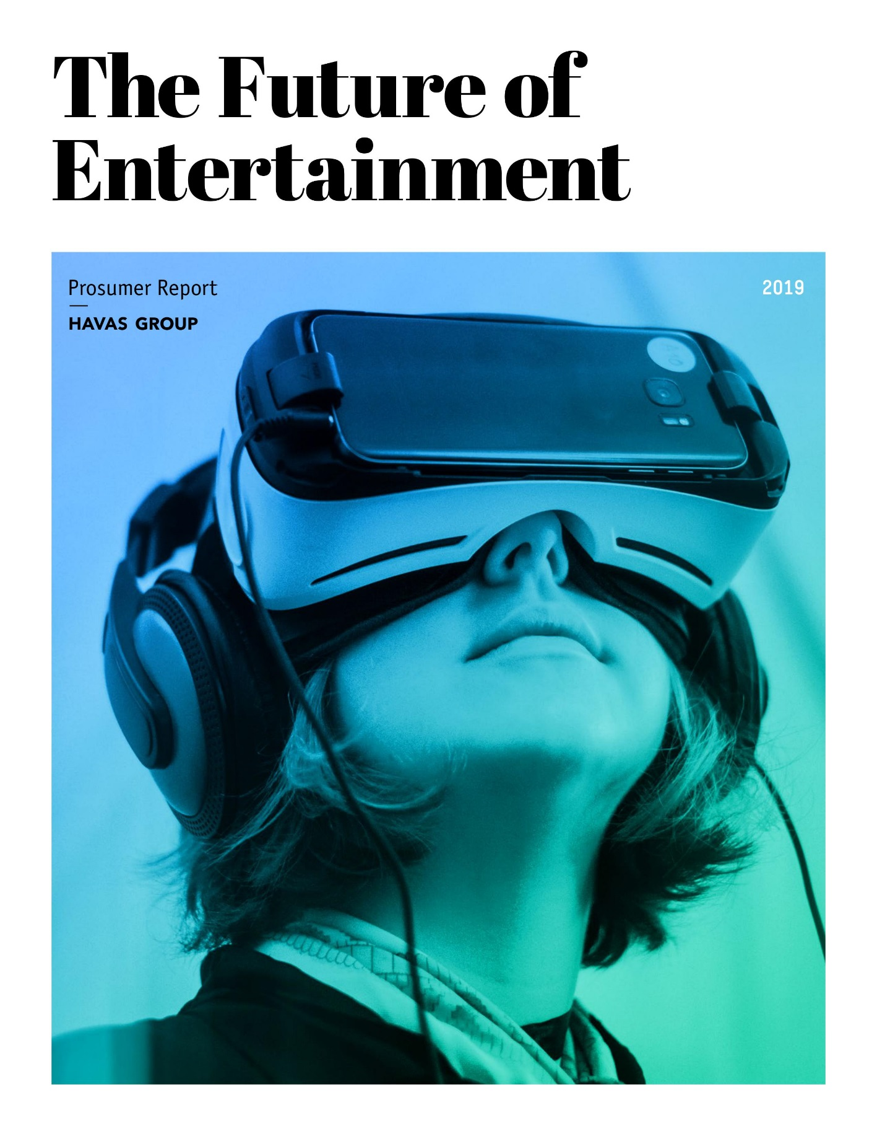
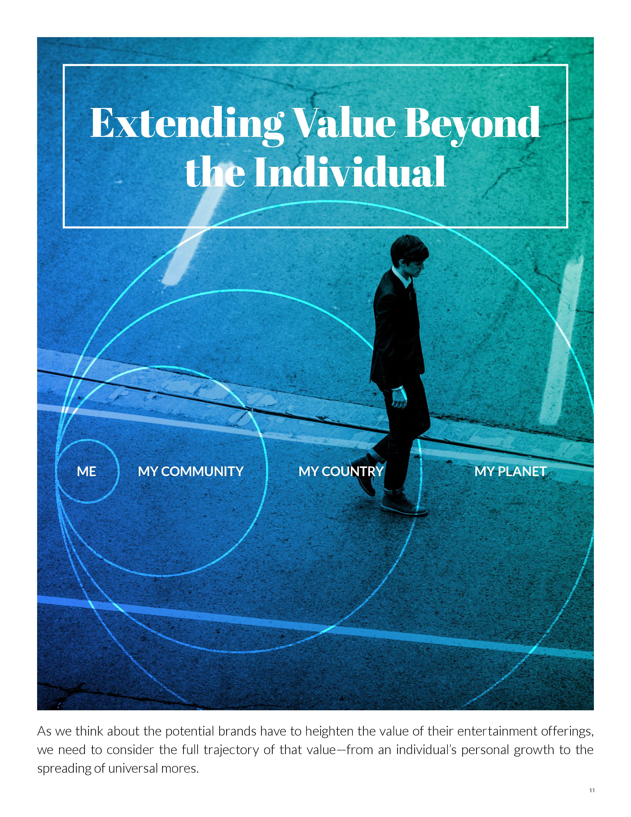
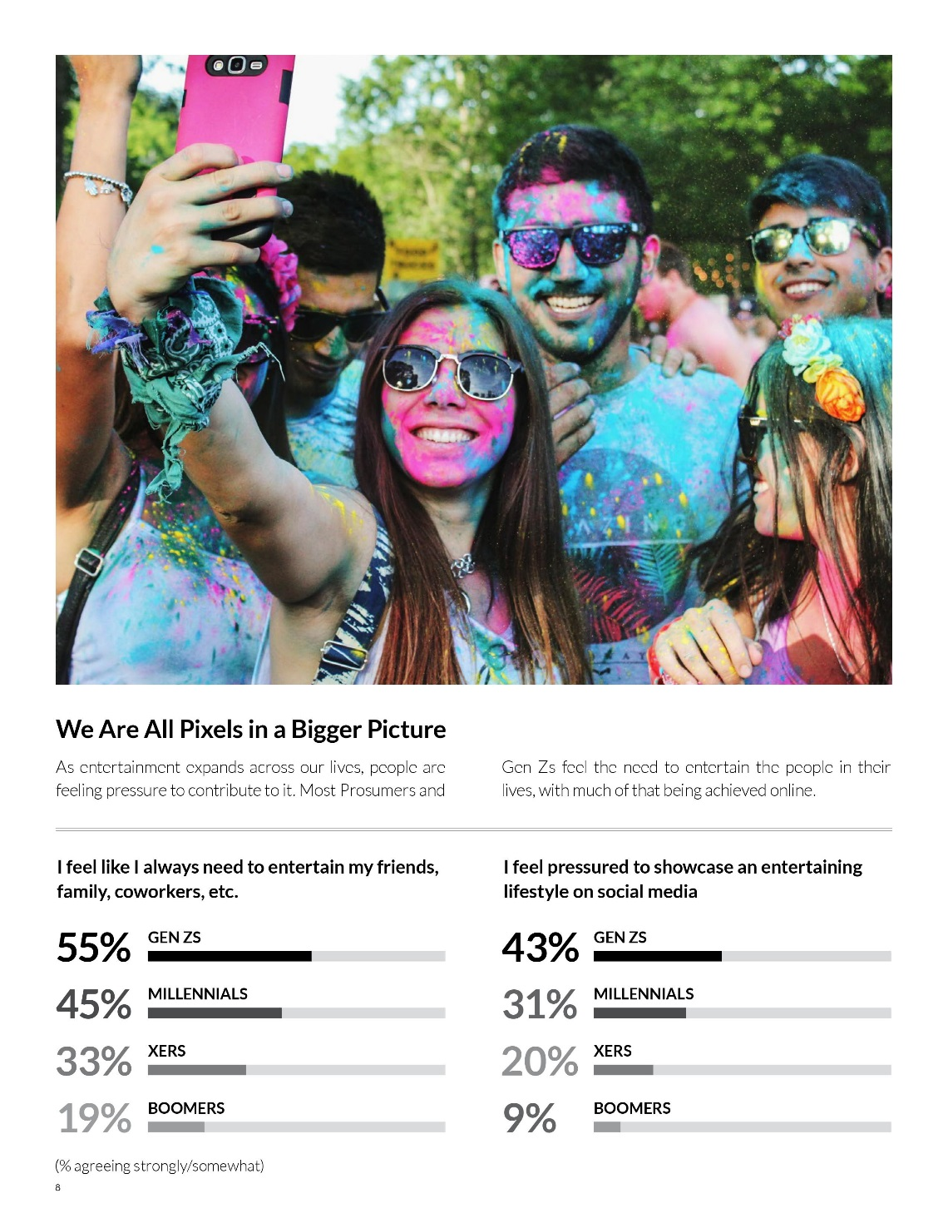
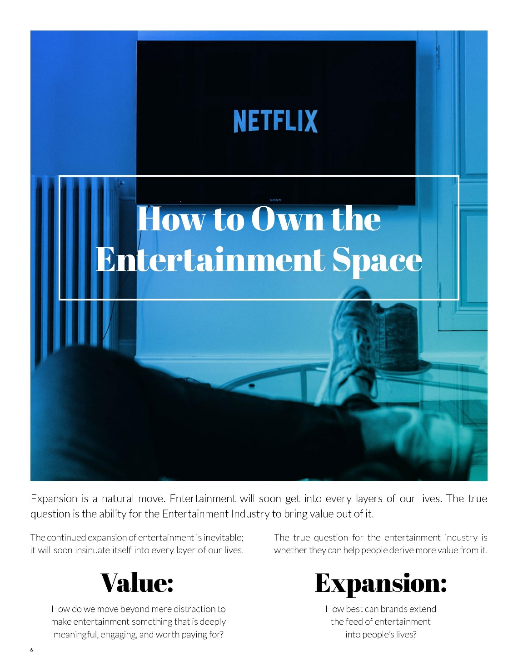
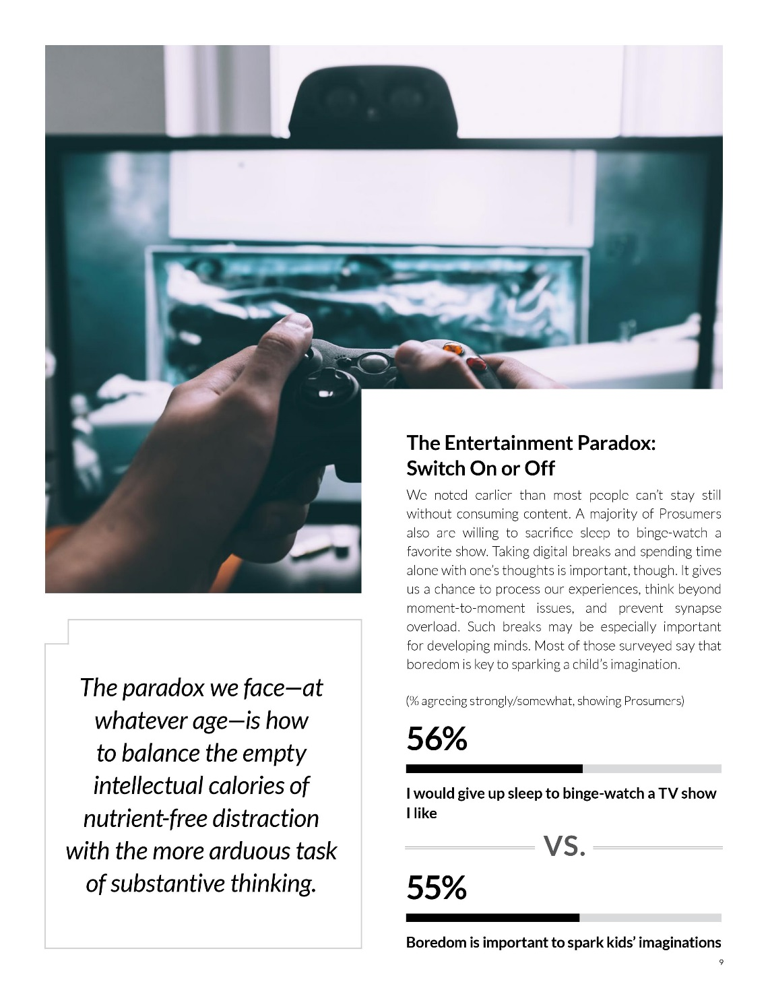
Who we are
Havas Group is one of the world’s largest global communications groups, bringing together 20,000 people in more than 100 countries. Havas is part of Vivendi, a world-class content, media, and communications group with European roots, whose other businesses include Universal Music Group, Canal+ Group, Editis, Gameloft, and Dailymotion. The companies work together cohesively as an integrated group to create greater value.
Home to the entire marketing community, Cannes Lions shapes the creative marketing agenda. Cannes Lions explores the value of creativity in branded communications, welcoming attendees from entertainment, advertising, marketing, technology, innovation, and design. The five-day festival and awards provide the industry with access to beautiful new ideas, pioneering consumer research, and emerging technologies that will help make and shape popular culture.
Learn more at havas.com/thefutureofentertainment.

